Slide 1

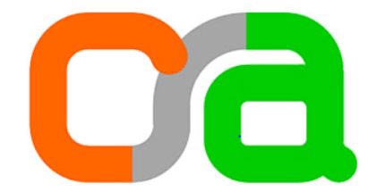
Privacy-Preserving Verification on Social Media Using Zero-Knowledge Proofs
Advisor : Chaya Ganesh
Student : Sindhura S

Slide 2
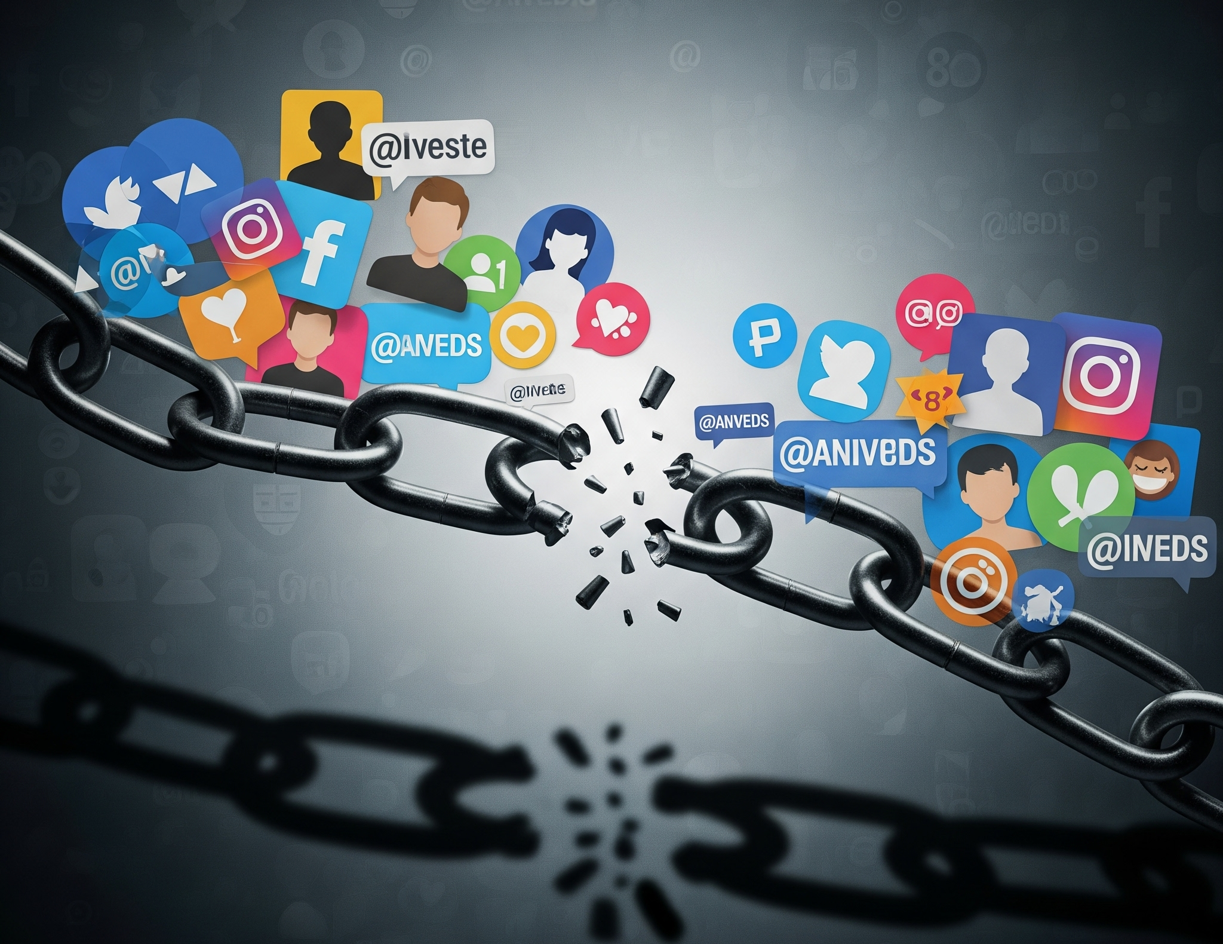
Motivation
Social media verification ambiguity erodes trust.
Paid badges mix subscription with true identity.
Impersonation risk increases with verification issues.
Need for secure system to verify identity.

Slide 3
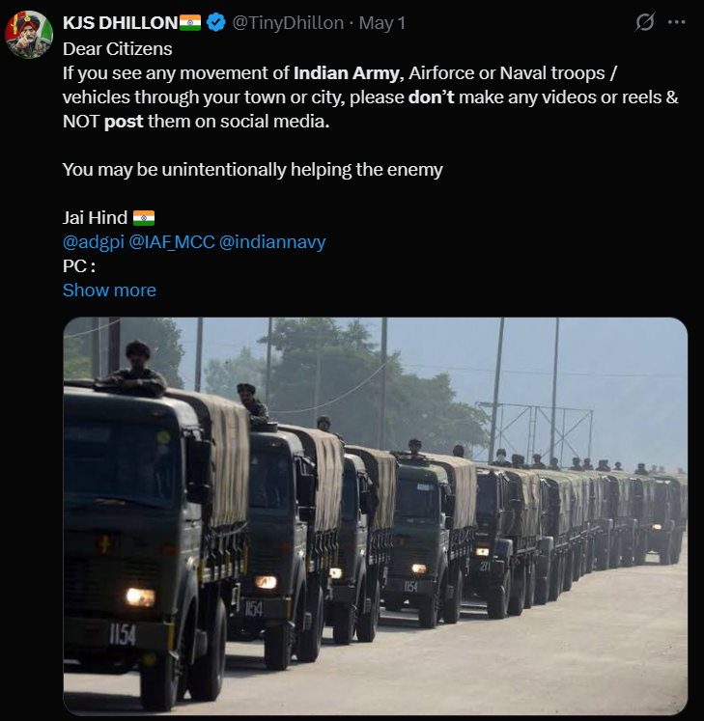

Slide 4
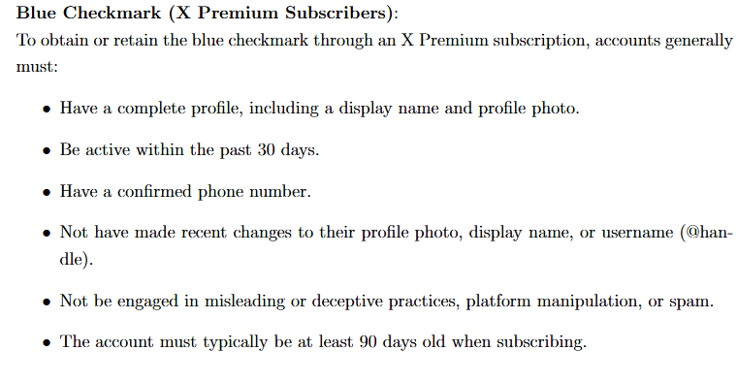
Current Verification : After Nov 9 , 2022 (7.99$ month US)

Slide 5
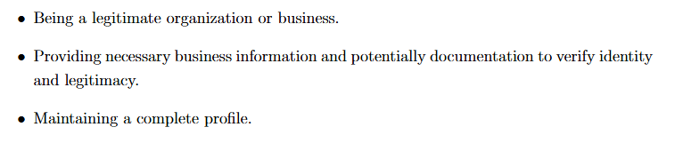
Grey/Gold Checkmark : $1000 per month for Gold Checkmark

Slide 6
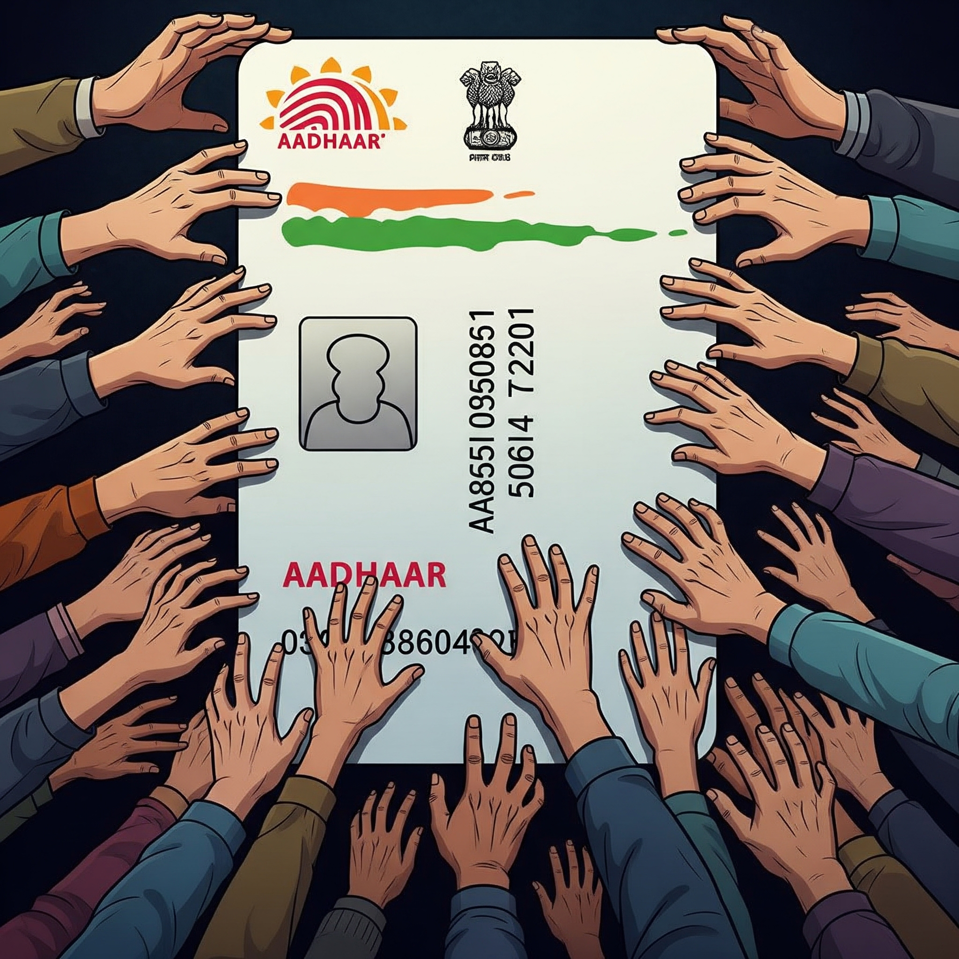
Why not Aadhaar
Consent needed
Storage of Aadhaar
Increase in cost
Individual to country

Slide 7
Paper 1: "I can say I'm John Travolta... but I'm not John Travolta,: The effects of twitter verification and badge design on perceptions of trust.
Method: Controlled experiment with 1,600 U.S. participants shown mock social media posts.
Key Finding:
Government ID required: 30% more likely to be seen as credible .
Only notable accounts eligible: 80% more likely to be seen as credible.
Relevance: Aligns directly with user preference for trustworthy verification .

Slide 8
Paper 2: Account Verification on Social Media: User Perceptions and Paid Enrollment.
.
Method: survey of 299 U.S. users with a measurement study of 2.85 million Twitter accounts.
Key Finding:.
Over 50% of users incorrectly believed Twitter's paid blue check still required proof of identity.
Over 80% misunderstood the meaning of the newer gold and gray check marks .
Relevance: user confusion problem.

Slide 9
Paper 3: Evaluating Twitter's Algorithmic Amplification of Low-Credibility Content: An Observational Study.
.
Method: Observational study of 2.7 million tweets on COVID-19 and climate change.
Key Finding:
COVID-19 topics: +19.2% more impressions than high-credibility domains.
Climate change topics: +95.8% more impressions amplified High-credibility domains.
Relevance: danger of compromised badge can game the algorithm.

Slide 10
Paper 4: The unverified era: politicians' Twitter verification post-Musk acquisition..
.
Method: Quantitative analysis of 5,156 accounts of European politicians after April 2023 policy changes.
Key Finding:
Over 80% of previously verified politicians lost their verification status .
The new gray badge for government figures was applied inconsistently and sparsely .
Relevance: A mass-deverification event created an authority vacuum.

Slide 11


Proposed : Two-Tier Verification Framework
 | Blue Badge (Subscription) | Green Badge (Authenticity)
Purpose | Grants access to premium platform features for a fee. | A high-assurance, reliable signal of genuine identity.
Acquisition Method | Subscription for a fee. | Cryptographically verified authenticity using Zero-Knowledge Proofs.
What It Means | Signifies a commercial relationship, NOT verified identity. | Cryptographically verified authenticity.

Slide 12
Green Badge Architecture:
User/Entity (Prover): Recognized ppl , Govt, Private Cop
Unique Identification Authority of India (UIDAI ) Masked Aadhaar XML
Ministry of Corporate Affairs (MCA) issues the Certificate of Incorporation (COI)
National Informatics Centre (NIC) issues domain registration certificate
Client-Side Tool: Parses documents and generates proof locally on the user's device .
Social Media Platform (Verifier): Receives and verifies the proof, never the raw document .

Slide 13
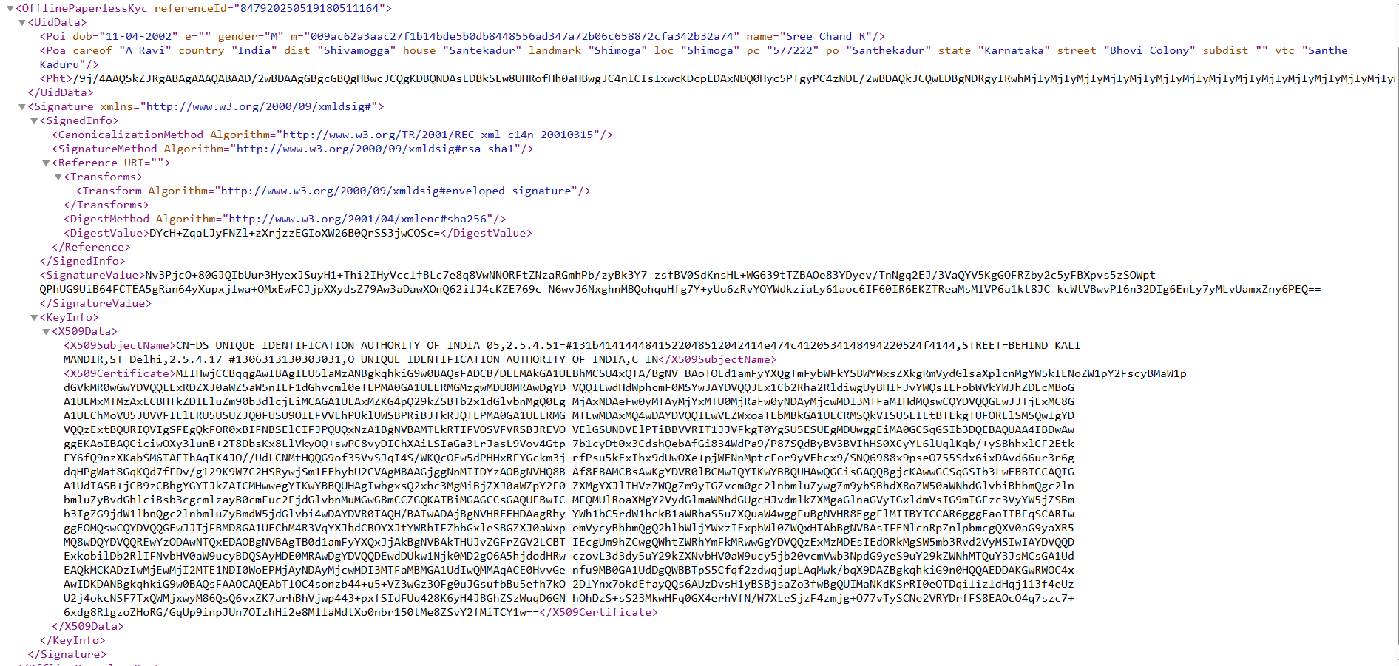

Slide 14
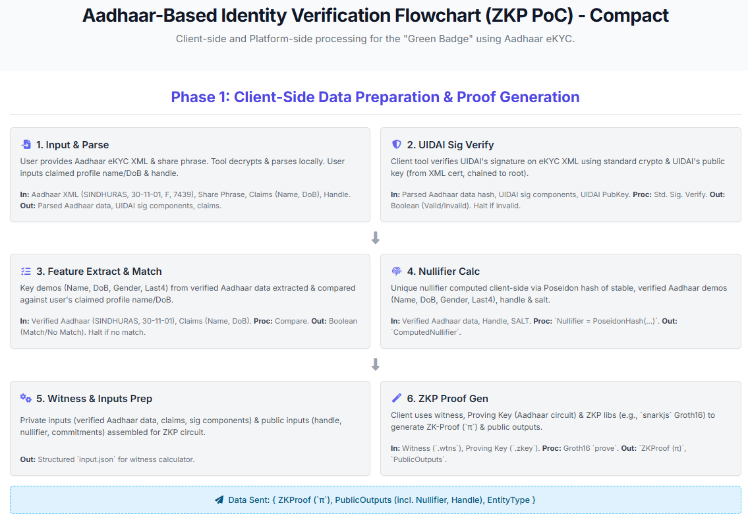

Slide 15
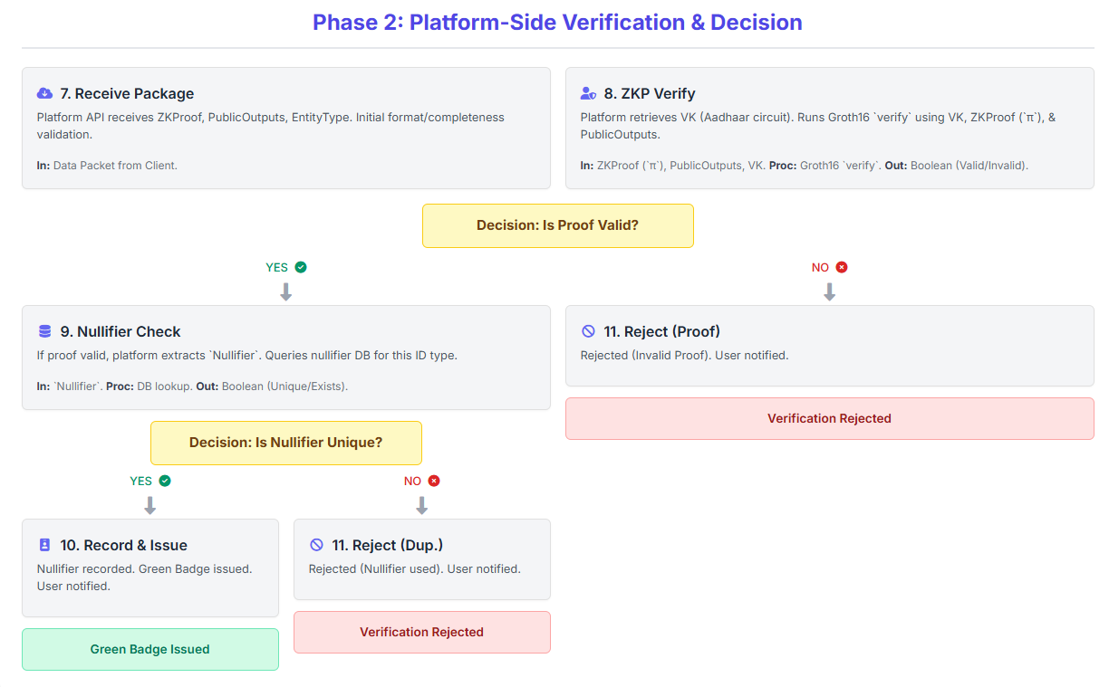

Slide 16
DEMO

Slide 17
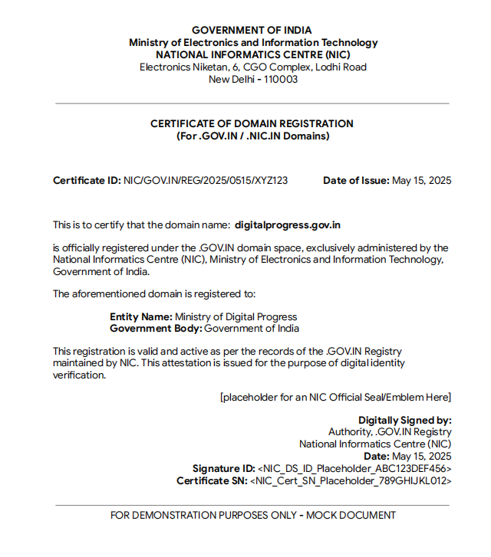
GOVT :

Slide 18
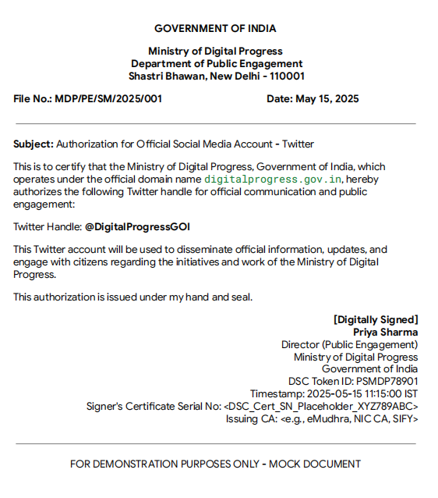

Slide 19
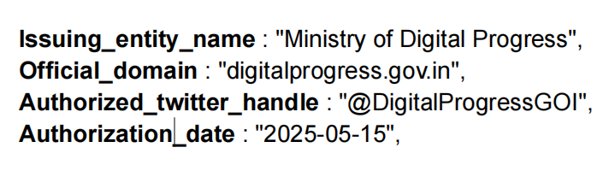
Feature Extraction :

Slide 20
Intuition for Security & Privacy Analysis
Resilience Against Attacks:
Impersonation: cryptographically signed, authoritative documents and DSCs.
Fraudulent Proofs: computational soundness of Groth16, assuming a secure trusted setup.
Sybil Attacks: ZKP-enforced nullifier scheme.

Slide 21
Privacy Preservation (Core Goal Achieved):
Zero-Knowledge: Platform never sees the user's raw documents .
Client-Side Processing: All sensitive parsing occurs locally on the user's device.
Data Minimization: Platform only receives the proof and public commitments and stores only nullifier.
Founational Papers relevence

Slide 22
Pre Existing work :
Standard Sign verification Algorithm (public key and Private key)
Standard zk-snarks Groth16

Slide 23
Primary Contributions:
A Differentiated Two-Tier Verification Framework
Privacy-Preserving ZKP Circuits for National IDs
A Robust Sybil-Resistant Nullifier Scheme

Slide 24
Future Work
Conducting large-scale usability studies to evaluate the real-world effectiveness
Global Interoperability: Extend the framework by designing ZKP circuits for identity documents from other countries
From Theory to Production
.

